Slide 1
Will It Rain In Seattle?
Isabella Sturm
DSC 630

Slide 2

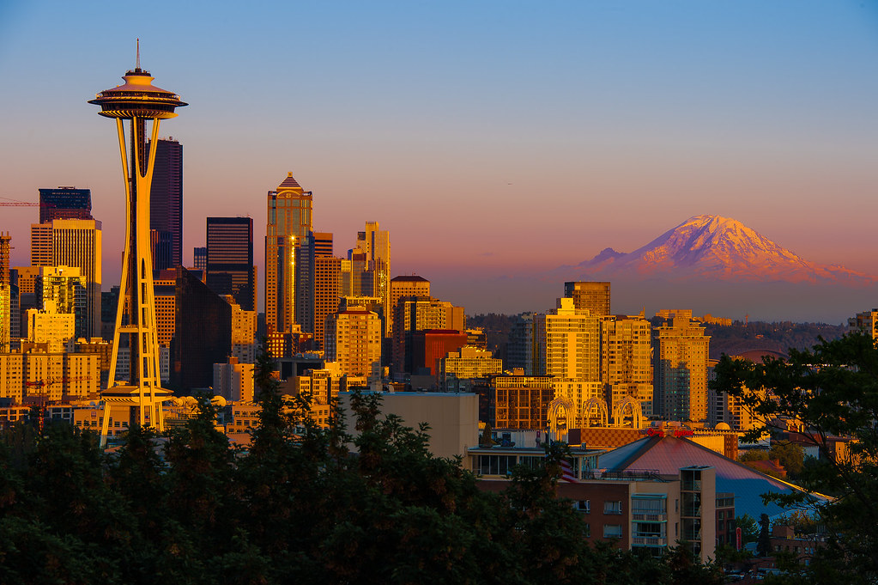
Why You Should Care
Marketing for Locals and Tourists
Planning Events in/around City
Notes:
This Photo by Unknown Author is licensed under CC BY-NC-ND
This Photo by Unknown Author is licensed under CC BY-SA-NC

Slide 3
Data Set – Rain in Seattle
Number Rows: 25,551
Date Range: 1948-01-01 to 2017-12-14
Columns (Features):
Date (yyyy-mm-dd)
Precipitation (inches),
Max Temperature (F)
Min Temperature (F)
Day (Sunday – Saturday)
Week (1-52)
Month (January – December)
Day of Month
Day of Year (1 – 365 or 366)

Slide 4
Data Preparation
Removed Missing Data (only 3 rows in initial dataset)
No outliers
Created new columns from the data
Day of Year
Day of Month
Week Day
Week in Year

Slide 5
Exploratory Results
Minimum vs Maximum Temperatures: Rain vs No Rain
Roughly evenly distributed, slightly skewed left
Could be useful predictor of rain

Slide 6
Exploratory Results
Day of Month: Rain vs No Rain
No apparent pattern that day of month can be used to predict if it will rain

Slide 7
Exploratory Results
Day of Year & Week of Year: Rain vs No Rain
Nearly inverses of each other, indicating it is probably a good predictor of rain.

Slide 8
Exploratory Results
Month: Rain vs No Rain
Nearly inverses of each other, indicating it is probably a good predictor of rain.

Slide 9
Exploratory Results
Day of Week: Rain vs No Rain
Similar counts for days of the week between days with rain vs no rain
Not clear indicator or predictor of rain

Slide 10
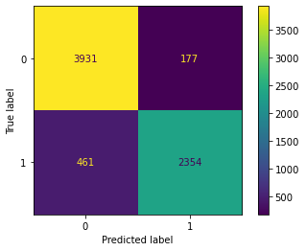
Prediction Models
Logistic Regression
Accuracy: 90.78%

Slide 11
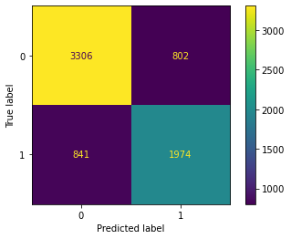
Prediction Models
K-Nearest Neighbors
Accuracy: 76.26%

Slide 12
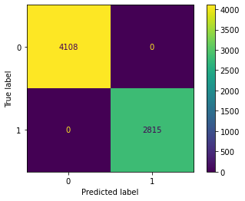
Prediction Models
Decision Tree
Accuracy: 100.00%

Slide 13
Challenges
Data: Methods for calculated values such as Day of Week, Month, Day of Month, Day of Year and Week of Year resulted in more rows with missing data
Ended up removing missing data but drastically reduced data size
Limited variables for analysis
Next steps would be to pull more weather related data such as humidity to see how predictions would change

Slide 14
Future Plans for Analysis
Currently have great results for analysis/predictions but could improve for fuller data picture
Pull more weather data variables to get a fuller picture of weather data predictions
Fix missing values from calculated fields to retain more data points for analysis
Retrain models with additional data

